Slide 1
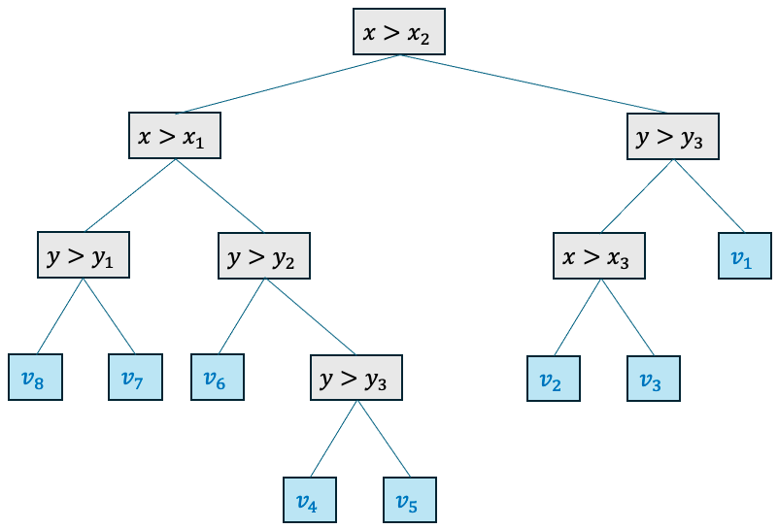
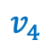
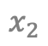
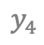
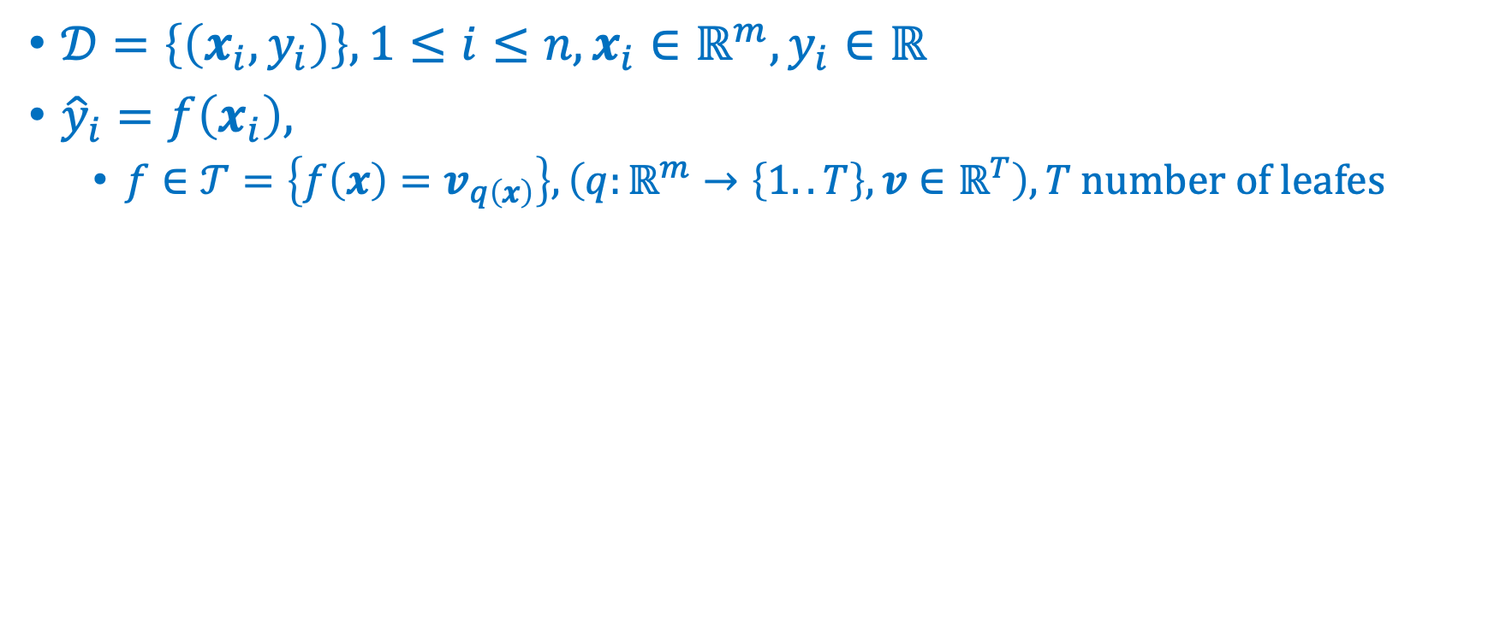
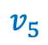
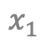
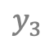

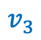
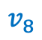
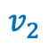
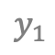
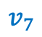
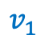
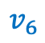
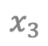
Trees
$𝒟=\left\{\left(x_{i},y_{i}\right)\right\}, 1≤i≤n, x_{i}∈ℝ^{m},y_{i}∈ℝ$
${\hat{y}}_{i}=f\left(x_{i}\right),$
$f∈𝒯=\left\{f\left(x\right)=v_{q\left(x\right)}\right\}, \left(q:ℝ^{m}→\left\{1..T\right\}, v∈ℝ^{T}\right), T \text{number} \text{of} \text{leafes}$
$$v_{4}$$
$$y_{4}$$
$$v_{1}$$
$$y_{3}$$
$$v_{7}$$
$$v_{5}$$
depth
$$y_{2}$$
$$v_{2}$$
$$v_{3}$$
$$y_{1}$$
$$v_{8}$$
$$v_{6}$$
$$x_{1}$$
$$x_{2}$$
$$x_{3}$$
Leave nodes

Slide 2
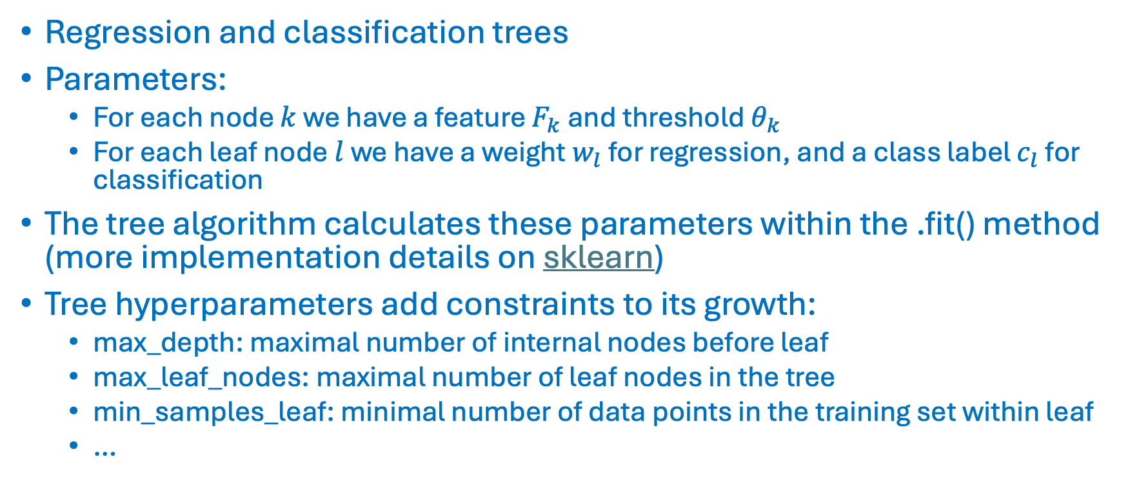
Trees
Regression and classification trees
Parameters:
For each node $k$ we have a feature $F_{k}$ and threshold $θ_{k}$
For each leaf node $l$ we have a weight $w_{l}$ for regression, and a class label $c_{l}$ for classification
The tree algorithm calculates these parameters within the .fit() method (more implementation details on sklearn)
Tree hyperparameters add constraints to its growth:
max_depth: maximal number of internal nodes before leaf
max_leaf_nodes: maximal number of leaf nodes in the tree
min_samples_leaf: minimal number of data points in the training set within leaf
…

Slide 3
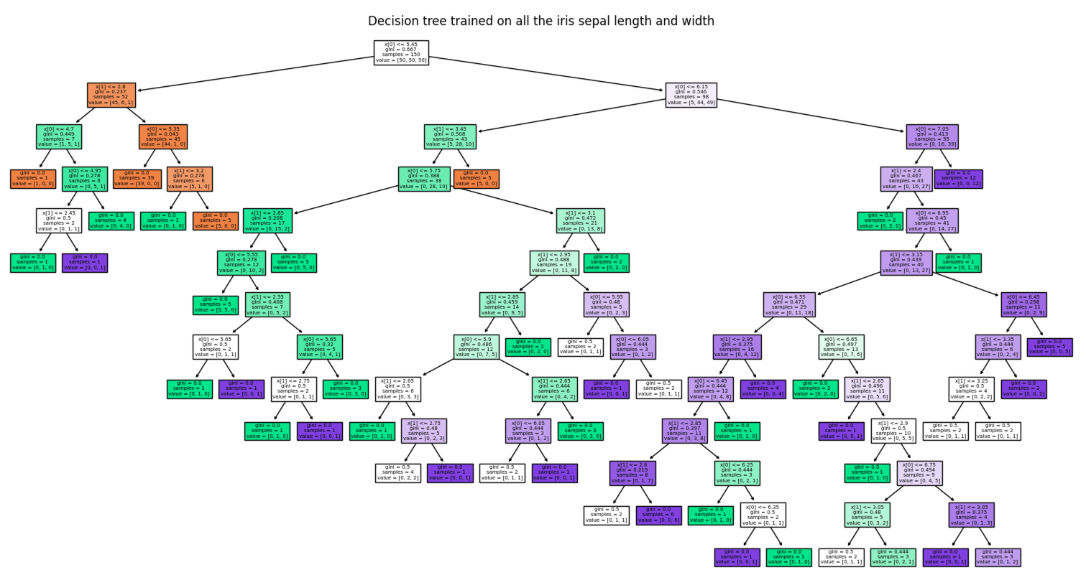
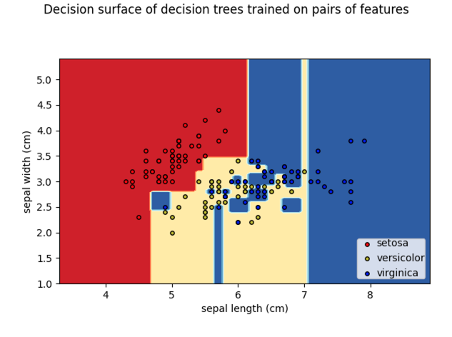
Trees
Code on sklearn page !

Slide 4
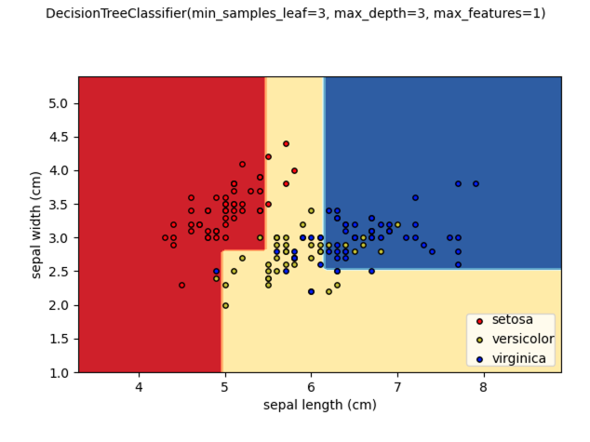
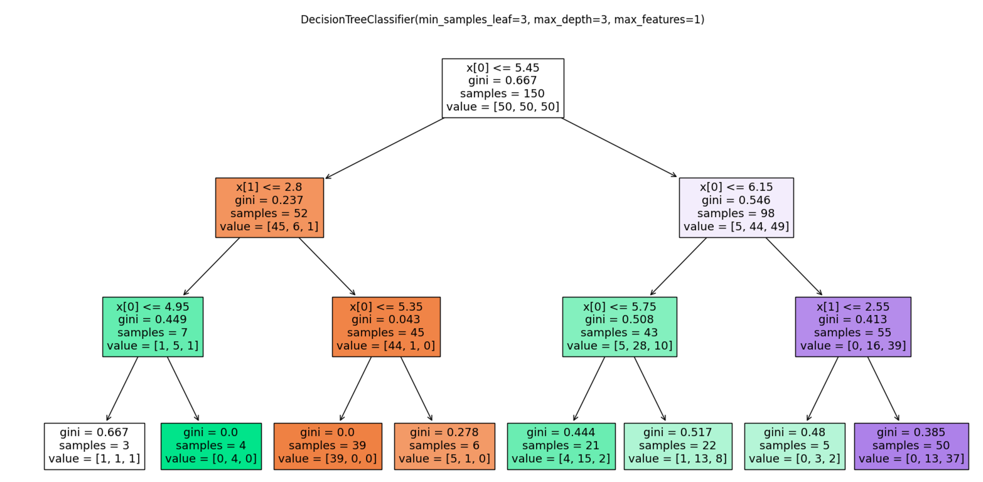
Tree hyperparamters

Slide 5
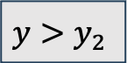
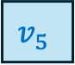
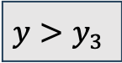
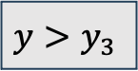
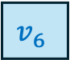
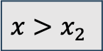
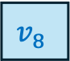
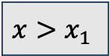
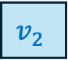
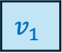
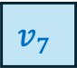
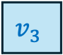
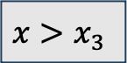
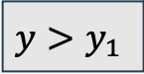
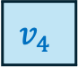
$$x>x_{2}$$
$$x>x_{1}$$
$$y>y_{3}$$
$$y>y_{1}$$
$$y>y_{2}$$
$$x>x_{3}$$
$$v_{1}$$
$$v_{8}$$
$$v_{7}$$
$$v_{6}$$
$$y>y_{3}$$
$$v_{2}$$
$$v_{3}$$
$$v_{4}$$
$$v_{5}$$

Slide 6
Bagging and Boosting
Obtain a good classifier by combining many basic, weak classifiers
Classifiers have two types of errors:
Bias (e.g. linear classifiers)
Variance (e.g. kNN, trees, unstable classifiers)
Weak classifiers are for example linear classifiers (high bias for non-linear problems) or tree classifiers (high variance without pruning)
Weak classifiers have either a high bias and/or high variance
Weak classifiers have to be better than random labels

Slide 7
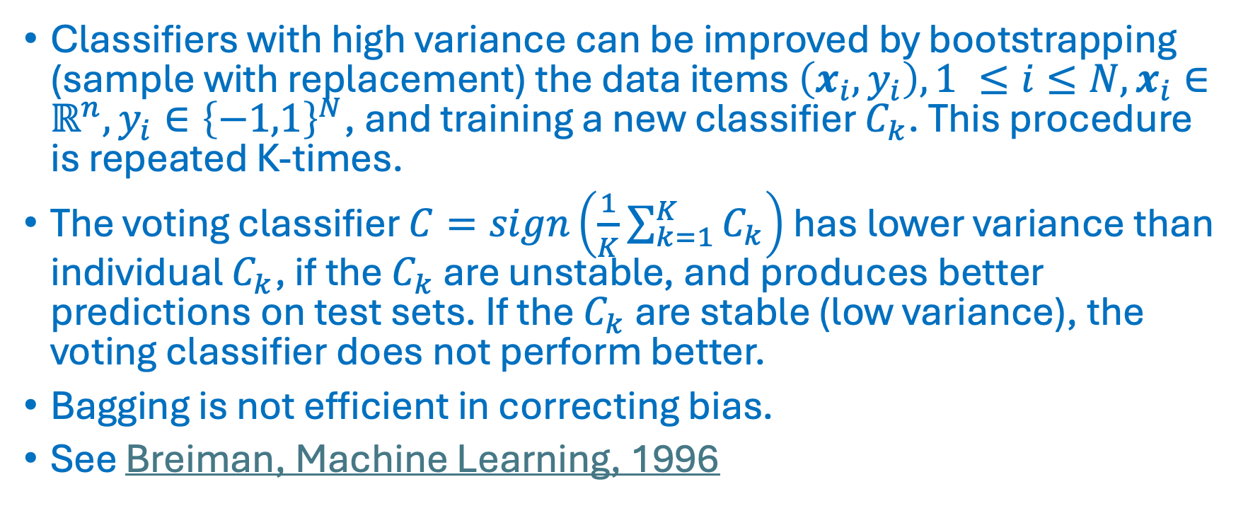
Bagging
Classifiers with high variance can be improved by bootstrapping (sample with replacement) the data items $\left(x_{i},y_{i}\right), 1 ≤i≤N, x_{i}∈ℝ^{n}, y_{i}∈{\left\{−1,1\right\}}^{N}$, and training a new classifier $C_{k}$. This procedure is repeated K-times.
The voting classifier $C=sign\left(\frac{1}{K}\sum_{k=1}^{K}{C_{k}}\right)$ has lower variance than individual $C_{k}$, if the $C_{k}$ are unstable, and produces better predictions on test sets. If the $C_{k}$ are stable (low variance), the voting classifier does not perform better.
Bagging is not efficient in correcting bias.
See Breiman, Machine Learning, 1996

Slide 8
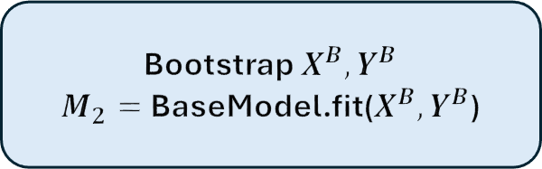
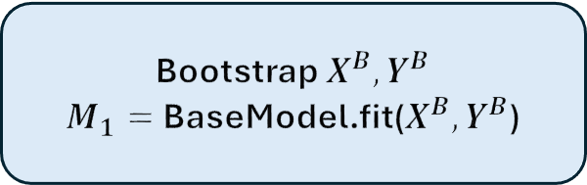
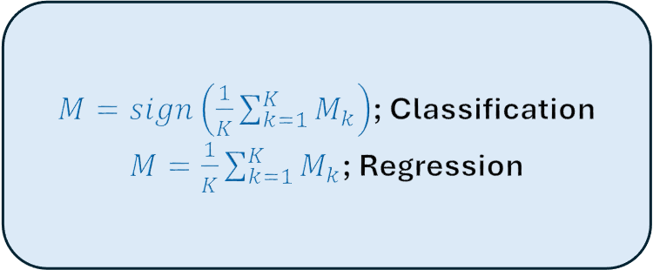
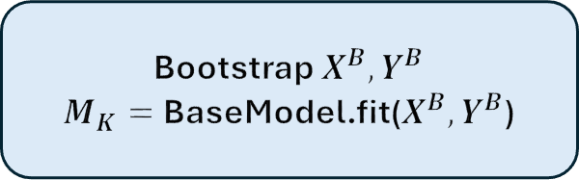
Bagging
Bootstrap $X^{B},Y^{B}$
$M_{1}=$BaseModel.fit($X^{B},Y^{B}$)
$M=sign\left(\frac{1}{K}\sum_{k=1}^{K}{M_{k}}\right)$; Classification
$M=\frac{1}{K}\sum_{k=1}^{K}{M_{k}}$; Regression
Bootstrap $X^{B},Y^{B}$
$M_{2}=$BaseModel.fit($X^{B},Y^{B}$)
Bootstrap $X^{B},Y^{B}$
$M_{K}=$BaseModel.fit($X^{B},Y^{B}$)

Slide 9
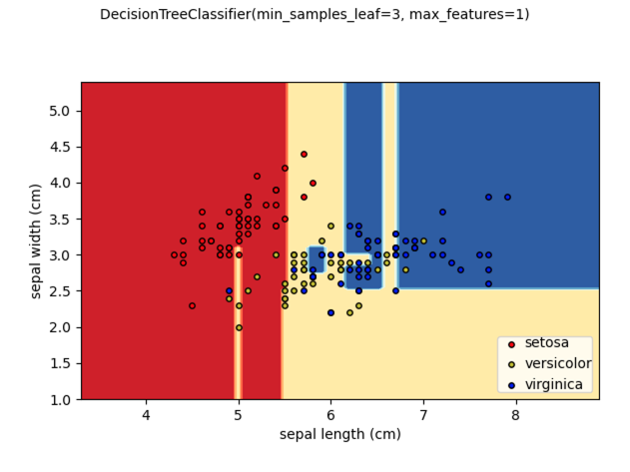
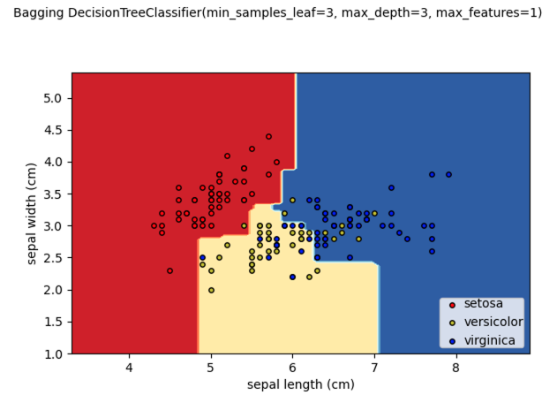
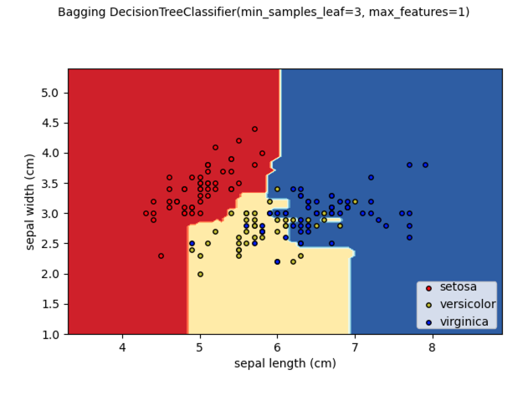
Bagging
K = 1
K = 100

Slide 10
Random Forest
Bootstrapped samples in bagging are similar and produce correlated base model outputs, which decreases the efficiency of bagging.
Random Forest is a bagging approach where both data items and features are sampled in order to de-correlate the trees.
A predefined number of features is sampled at each decision node in the tree. The splits in that node can only involve the selected features.
Base trees can be pruned with the max_depth, max_leaf_nodes, min_samples_leaf, … hyperparameters
Breiman, Machine Learning, 2001

Slide 11
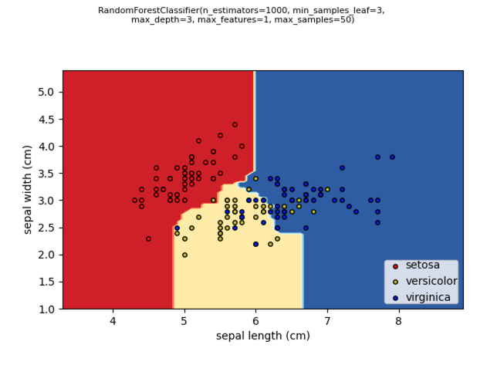
Random Forest
RandomForestClassifier on sklearn

Slide 12
Boosting
Bagging algorithms and RF can decrease the variance, but they cannot efficiently correct the bias of a weak classifier.
The AdaBoost algorithm (Freund & Shapire, ICML, 1996) corrects the bias too, and offers a very powerful method, which works well for many data types.
In each iteration, boosting tries to correct the error of the previous iteration by increasing the weights of the misclassified data items.
The current classifier focuses on those misclassified data points and is added to the previous classifiers.

Slide 13
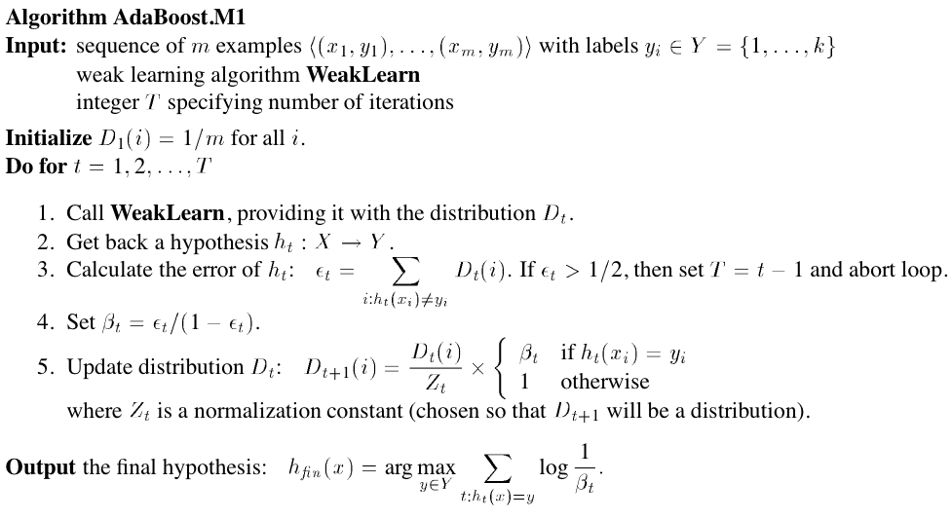
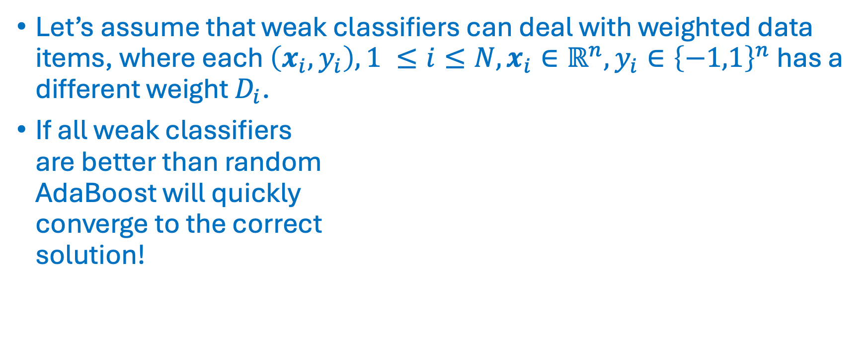
AdaBoost
Let’s assume that weak classifiers can deal with weighted data items, where each $\left(x_{i},y_{i}\right), 1 ≤i≤N, x_{i}∈ℝ^{n}, y_{i}∈{\left\{−1,1\right\}}^{n}$ has a different weight $D_{i}$.
If all weak classifiers are better than random AdaBoost will quickly converge to the correct solution!

Slide 14
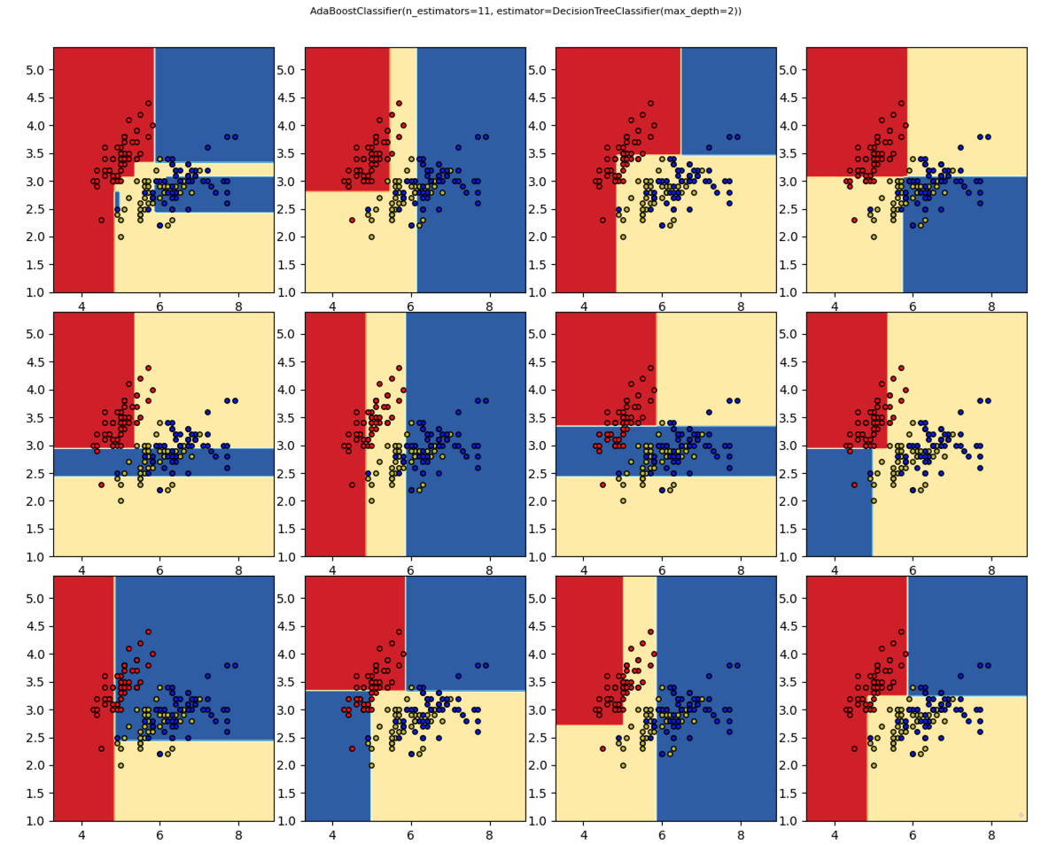
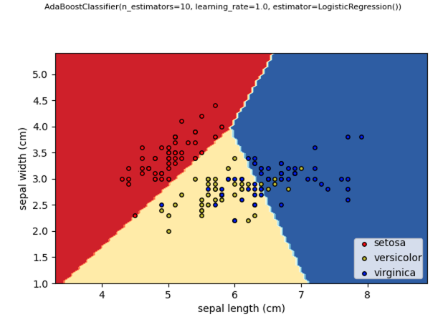
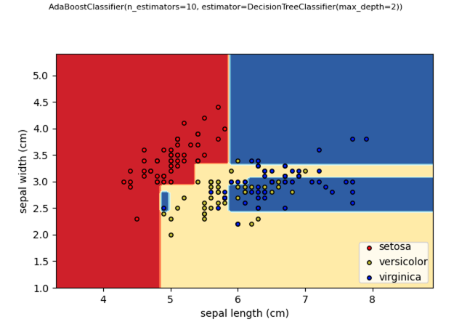
AdaBoost

Slide 15
Gradient Boosting
Mason et al. (Mason et al., NIPS, 1999) showed that AdaBoost is a special case of the Gradient Boosting framework.
In the gradient boosting framework, you choose a cost function and select a weak classifier, which minimizes the gradient of the cost function (in function space)
Mason et al. showed that some cost functions can perform better than AdaBoost, which is more prone to overfitting.
For a thourough comparison of bagging and boosting methods see Dietterich, Machine Laerning, 2000.

Slide 16
XGBoost: a scalable and flexible gradient boosting system
Introduced by Chen & Guestrin in 2016 (Chen & Guestrin, KDD 16, 2016)
Efficient and configurable implementation for tree and linear boosting for regression, classification and ranking.
Support for parallelization, cluster computing and GPU.
User can choose cost function and contraints on trees.
XGBoost beats neural network models on tabular data (KDDCup 2015, Shwartz-Ziv & Armon, arXiv, 2021)

Slide 17
XGBoost
Exact greedy (slower) and approximate (faster) algorithms
Deal with missing values (sparsity aware)
Include feature interaction constraints
Include monotonicity constraints
Include regularization (shrinkage, sampling, penalties)
Callbacks, early stopping
Parallel on multiple CPUs, support for Spark distributed computing
GPU support
Out-of-core computing (data larger than memory)
Since 2.0: optimize histo size, learning to rank, quantile regression, federated learning

Slide 18

XGBoost
${\hat{y}}_{i}=φ\left(x_{i}\right)=\sum_{k=1}^{K}{f_{k}\left(x_{i}\right)}$
$ℒ\left(φ\right)=\sum_{i=1}^{n}{l\left({\hat{y}}_{i},y_{i}\right)+}\sum_{k=1}^{K}{Ω\left(f_{k}\right)}$ : regularized learning objective
$l\left({\hat{y}}_{i},y_{i}\right)$ = loss function (e.g. square loss $l\left({\hat{y}}_{i},y_{i}\right)={\left({\hat{y}}_{i}−y_{i}\right)}^{2}$)
$Ω\left(f\right)=γT+\frac{1}{2}λ\left\|v^{2}\right\|$
But searching over all combinations of trees is too slow

Slide 19

XGBoost
Boosting: fit tree to error $y_{i}−{\hat{y}}_{i}^{t−1}$of previous iteration
$ℒ^{t}\left(φ\right)=\sum_{i=1}^{n}{l\left(y_{i},{\hat{y}}_{i}^{t−1}+f_{t}\left(x_{i}\right)\right)+}Ω\left(f_{t}\right)$
Gradient boosting:
$ℒ^{t}\left(φ\right)≈\sum_{i=1}^{n}{l\left(y_{i},{\hat{y}}_{i}^{t−1}\right)+g_{i}f_{t}\left(x_{i}\right)+\frac{1}{2}h_{i}f_{t}^{2}\left(x_{i}\right)+}Ω\left(f_{t}\right)=\sum_{i=1}^{n}{l\left(y_{i},{\hat{y}}_{i}^{t−1}\right)+}{\tilde{ℒ}}^{t}\left(q\right)$
$g_{i}=\frac{∂}{∂{\hat{y}}_{i}^{t−1}}l\left(y_{i},{\hat{y}}_{i}^{t−1}\right)$; $h_{i}=\frac{∂^{2}}{∂^{2}{\hat{y}}_{i}^{t−1}}l\left(y_{i},{\hat{y}}_{i}^{t−1}\right)$

Slide 20

XGBoost
Initialize $f_{0}\left(x\right)=\underset{v,q}{argmin}{ℒ\left(f\right)}$
$\text{for} k=1..K$
Sample columns of $X$ and/or rows of $X, y$
$f_{k}\left(x\right)=\underset{v,q}{argmin}{{\tilde{ℒ}}^{t}\left(v,q\right)}$ (see below)
$φ_{k}\left(x_{i}\right)=$ $φ_{k−1}\left(x_{i}\right)+η$ $f_{k}\left(x\right)$, shrinkage parameter eta $0<η≤1$
Output $φ_{K}\left(x_{i}\right)$

Slide 21

XGBoost
Assume $f_{t}$ is fixed appart from the leaf values $v$
Define $I_{j}=\left\{i | q\left(x_{i}\right)=j\right\}$, i.e. all points $x_{i}$ belonging to leaf $j$
Then the optimal leaf values are:
$v_{j}=−\frac{\sum_{i∈I_{j}}{g_{i}}}{\sum_{i∈I_{j}}{h_{i}+λ}}$
${\tilde{ℒ}}^{t}\left(q\right)=−\frac{1}{2}\sum_{j=1}^{T}{\frac{{\left(\sum_{i∈I_{j}}{g_{i}}\right)}^{2}}{\sum_{i∈I_{j}}{h_{i}+λ}}}+λT$
The tree finding algorithm finds the splits that minimize ${\tilde{ℒ}}^{t}\left(q\right).$

Slide 22

XGBoost

Slide 23
XGBoost
XGBoost is a scalable gradient boosting system
It is open source (https://github.com/dmlc/xgboost) and well documented (https://xgboost.readthedocs.io/en/stable/)
It performs very well on tabular data and won several competitions (eg. KDDCup 2015) beating neural networks (NN).
Unlike neural nets it relies on feature selection and engineering.

Slide 24


Hyperparameters
In the classification task, we would like to predict the outcome $y$ from the features $X$.
We choose a classifier $𝒞_{φ}$ with hyper parameters $φ$ and internal parameters $θ$.
Hyper parameters (e.g $k$ in $k−NN$, kernel in $SVM$, learning rate in $LR$) have to be specified by the user or learned in CV loop outside the classifier.
The internal parameters $θ$ are learned by the classifier (e.g. the coefficients in $LR$, or support vector coefficients in $SVM$).
The classifier learns those internal parameters $θ$ that are able to predict $y$ from the features $X$ with the lowest error: $θ=\underset{θ}{argmin}{ℒ\left(𝒞_{φ}\left(X,θ\right),y\right)}$ where the loss function $ℒ$ measures the error between predicted ($𝒞_{φ}\left(X,θ\right)$) and known ($y$) outcomes.

Slide 25
Hyperparameter optimization
ML models have internal parameters, which are learned by the training algorithm, and hyperparameters, which have to be set before training.
Both internal - and hyperparameters have a strong impact on the performance of the ML model.
There is a tradeoff between CPU/GPU cycles spent on hyperparameter optimization and training. Recent results show that allocating more cycles for hyperparameter optimization can be more rewarding.
Hyperparameter optimization is implemented as an outer loop over the CV loop

Slide 26
Hyperparameter optimization
Hyperparameters have tree-structured configuration spaces of discrete, ordinal, and continuous variables.
Hyperparameter optimization can be based on complete tree searches, random searches, or clever algorithms that suggest which parameter combination to test in the next step based on previous results.
Hyperopt (Bergstra et al. Neurips 2011) implements the latter two strategies. It implements sophisticated algorithms to suggest new parameter combinations (see below). It is open-source and available on https://github.com/hyperopt/hyperopt.
Other tools are Hypermax (tree parzen estimator), Scikit-Optimizer (skopt) (Bayesian), Spearmint (Bayesian), Hyperband (fast random armed bandit), Optuna (dynamic search space, pruning, easy API)

Slide 27
Hyperopt
Random algorithms find optimal solutions faster and more accurately than grid searches (Bergstra & Bengio, J. Mach. Learn. Res., 2012)
Therefore Hyperopt implements a random search algorithm.
Hyperopt also offers three model-based search algorithms:
Gaussian process approach (GP)
Tree-structured Parzen window approach (TPE)
Random

Slide 28


Hyperopt’s model-based algorithm
$$S\left(x, M\right)={EI}_{y^{∗}}\left(x\right)=\int_{−∞}^{+∞}{\max_{ }\left(y^{∗}−y,0\right)p_{M}\left(y | x\right)dy}$$
$$EI: \text{Expected} \text{improvement} \text{of} \text{hyperscore} \text{values} x$$

Slide 29





Hyperopt’s GP algorithm
$$S\left(x, M\right)={EI}_{y^{∗}}\left(x\right)=\int_{−∞}^{+∞}{\max_{ }\left(y^{∗}−y,0\right)p_{M}\left(y | x\right)dy};y^{∗}=\min_{ }\left\{f\left(x_{i}\right), 1≤i≤n\right\}$$
$p_{M}\left(y | x\right)$: estimated by gaussian process (GP)
The GP algorithms will give a large EI value for hyperscore
values $x$ if a large probability mass is below $y^{∗}$. This is the
case for
values of $x$ close to the minimum
values of $x$ in not yet explored regions, which have a large uncertainty
$$y^{∗}$$

Slide 30










Hyperopt’s TPE algorithm
$$S\left(x, M\right)={EI}_{y^{∗}}\left(x\right)=\int_{−∞}^{+∞}{\max_{ }\left(y^{∗}−y,0\right)p_{M}\left(y | x\right)dy}=\int_{−∞}^{y^{∗}}{\underset{ }{\left(y^{∗}−y\right)}\frac{p_{M}\left(x | y\right)p\left(y\right)}{p\left(x\right)}{dy}}$$
$∝{\left(γ+\frac{g\left(x\right)}{l\left(x\right)}\left(1−γ\right)\right)}^{−1}$
$$y^{∗}=γ−\text{quantile}:p\left(y<y^{∗}\right)=γ$$
$$p_{M}\left(x | y\right)=\left\{\begin{aligned}l\left(x\right) \text{if} y≤y^{∗} \\ g\left(x\right) \text{if} y>y^{∗}\end{aligned}\right.$$
g$\left(x\right)$
The TPE algorithm will give a large EI value for hyperscore
values $x=\underset{x}{argmax}{{g\left(x\right)}/{l\left(x\right)}}, i.e.$it will choose hyperscores with large $l\left(x\right)$ and small $g\left(x\right)$.
$$y^{∗}$$
$$l\left(x\right)$$
TPE: Tree structured Parzen estimator

Slide 31





Feature selection and interpretation with Shapley values
Shapley values
Shap package: Lundberg et al., arXiv, 2019
Example of immunogenic Mutation x
ranked 12th in patient of test set
Feature importance plot
Notes:
SHAP (SHapley Additive exPlanation) values explain the output of a function f as a sum of the effects φi of each
feature being introduced into a conditional expectation. Importantly, for non-linear functions the order in which features
are introduced matters. SHAP values result from averaging over all possible orderings. Proofs from game theory show this is
the only possible consistent approach where 􏰀M φi = f (x). In contrast, the only current individualized feature attribution i=0
method for trees satisfies the summation, but is inconsistent because it only considers a single ordering [24].
local accuracy, missingness, and consistency. Local accuracy states that the sum of the feature attributions is equal to the output of the function we are seeking to explain. Missingness states that features that are already missing (such that zi′ = 0) are attributed no importance. Consistency states that changing a model so a feature has a larger impact on the model will never decrease the attribution assigned to that feature.

